Slide 1

Module 5 – Ordinations 2: Eigenanalysis based methods

Slide 2
Types of ordination
Distance-based ordination
attempt to faithfully relate differences in ordination space to distance (or dissimilarity)
Eigenanalysis-based ordination
attempt to faithfully place species or attributes along gradients (inferred or measured)

Slide 3
Types of ordination
Distance-based ordination
NMDS –Nonmetric Multidimensional Scaling
PCoA–Principal Coordinates Analysis
Eigenanalysis-based ordination
PCA –Principal Components Analysis
CA –Correspondence Analysis
DCA –Detrended Correspondence Analysis
CCA –Canonical Correspondence Analysis
RDA –Redundancy Analysis

Slide 4
PCA – principal components analysis
Objective:
To express covariation in many variables in a smaller number of composite variables
Seeks the strongest linear correlation structure among variables
Uses eigenanalysis:
To find linear equations that combine the original variables into fewer axes (eigenvectors)
To determine the variance explained by each axis (eigenvalues)
Assumes linear relationships
Uses Euclidean distances (uses double zeros)
Requires multivariate normality
Very sensitive to outliers
Notes:
Principal components analysis (PCA) is a method to summarise, in a low-dimensional space, the variance in a multivariate scatter of points. In doing so, it provides an overview of linear relationships between your objects and variables. This can often act as a good starting point in multivariate data analysis by allowing you to note trends, groupings, key variables, and potential outliers. Further, if you have a data set with many variables and relatively few objects (i.e. a "large p, small n" table), PCA can help collapse these many variables into a few principal components (PCs), which can be used in further analyses.

Slide 5
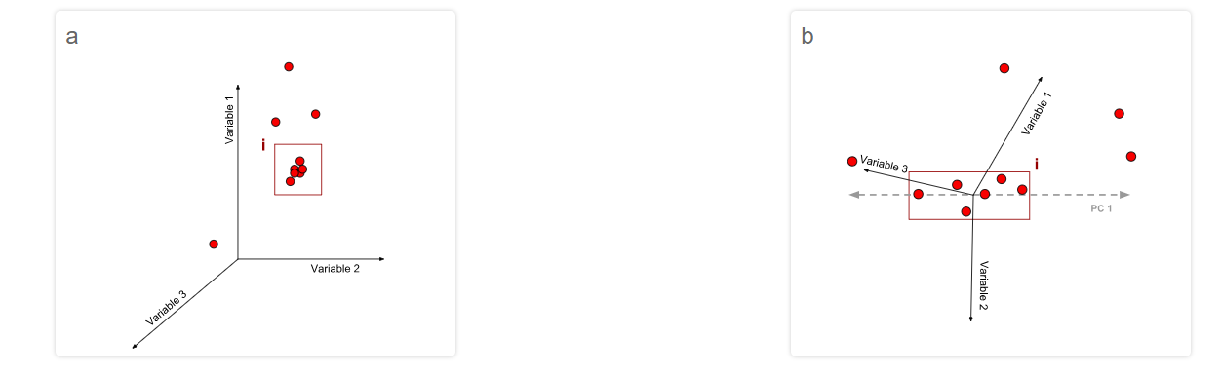
PCA – principal components analysis

Slide 6
PCA – principal components analysis
Eigenvector and Eigenvalue can give you the information on the scaling and rotational characteristics of a Matrix.
The first PC is placed through the scatter of points so as to maximize the amount of variation along it
The same criterion applies to each subsequent PC calculated;
However, each PC must be orthogonal to every other PC,
The covariance between each PC is strictly zero.

Slide 7
PCA – principle components analysis
If a few PCs capture most (70-90 %) of the variance in the original scatter, the PCA has been very successful in representing variability in your data
However, ecological data sets are rarely summarized so well. Smaller amounts of total variance captured (30-40%) can also be informative.

Slide 8
PCA – pre-analysis
If your response variables are not dimensionally homogeneous you should standardize them using, for example, z-scoring.
Examine the distribution of each variable as well as plots of each variable against other variables. If the relationships are markedly non-normal and non-linear, respectively, apply the appropriate transformations prior to analysis.
As far as possible, reduce the effect of outliers.

Slide 9
PCA – the procedure
Step 1: Get data with no(?) missing values
Step 2: Adjust data to mean = 0 – scale your data
Step 3: Calculate the covariance matrix
Step 4: Eigenanalysis of the covariance matrix
Step 5: Choose the principal components
Step 6: Derive a new dataset (scores)

Slide 10
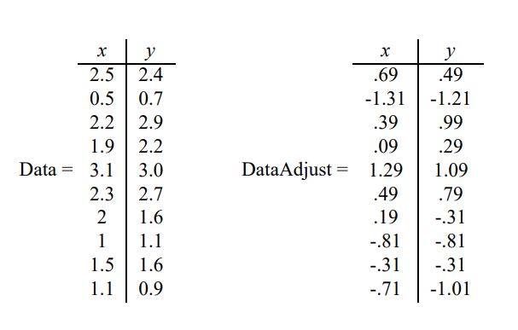
PCA – the procedure
Step 1: Get data with no(?) missing values
Step 2: Adjust data to mean = 0

Slide 11

PCA – the procedure
Step 1: Get data with no(?) missing values
Step 2: Adjust data to mean = 0 – scale your data
Step 3: Calculate the covariance matrix
is a measure of the extent to which corresponding elements from two sets of ordered data move in the same direction.

Slide 12
PCA – the procedure
Step 1: Get data with no(?) missing values
Step 2: Adjust data to mean = 0 – scale your data
Step 3: Calculate the covariance matrix
Step 4: Eigenanalysis of the covariance matrix

Slide 13
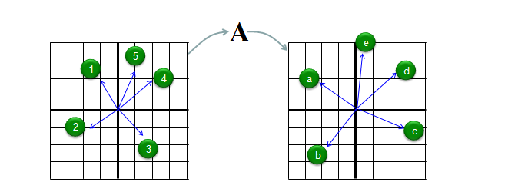
Eigenanalysis
The eigenvector represents an arrow pointing from the origin (0,0) to the point in 2-dimensional space = coefficients for a linear equation
Eigenvectors can be scaled, and in PCA, they are scaled to equal length = 1 (called unit eigenvectors)

Slide 14
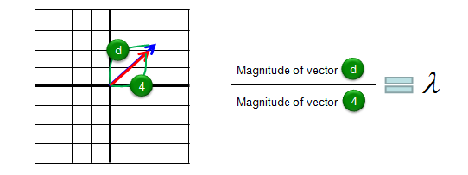
Eigenanalysis
The eigenvector represents an arrow pointing from the origin (0,0) to the point in 2-dimensional space = coefficients for a linear equation
Eigenvectors can be scaled, and in PCA, they are scaled to equal length = 1 (called unit eigenvectors)
Eigenvalues are the amount by which eigenvectors are scaled

Slide 15
Eigenanalysis
Finds the eigenvectors and eigenvalues
Eigenvectors are found using an iterative process that solves simultaneous linear equations (axes)
Eigenvalues are the roots of polynomial equations found using iterative computational algorithms
Highest eigenvalue belongs to the first Principal Component
Represent the amount of variance explained by each axis

Slide 16
PCA – the procedure
Step 1: Get data with no(?) missing values
Step 2: Adjust data to mean = 0 – scale your data
Step 3: Calculate the covariance matrix
Step 4: Eigenanalysis of the covariance matrix
Step 5: Choose the principal components

Slide 17
PCA – the procedure
Step 1: Get data with no(?) missing values
Step 2: Adjust data to mean = 0 – scale your data
Step 3: Calculate the covariance matrix
Step 4: Eigenanalysis of the covariance matrix
Step 5: Choose the principal components
Step 6: Derive a new dataset

Slide 18
PCA –additional notes
Eigenvalues represent the amount of variance explained by each axis
Because PCA is based on Euclidean distances, axes can be extracted and treated as composite variables in other analyses

Slide 19
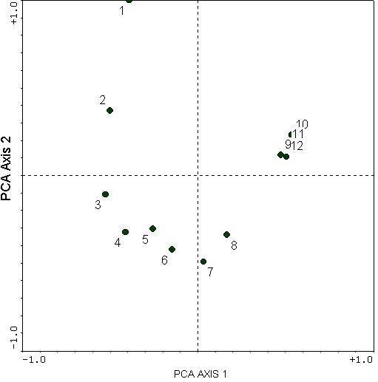
PCA – warnings!
Cannot handle non-linear data
Interprets shared zeros as positive relationships
Results in the “horseshoe effect”
Why it is bad for species comp data

Slide 20
PCA – advanced procedures
You can rotate your axes
PC factor analysis
RPCA
You can impute missing data
Ask yourself why first

Slide 21
PCA – What to report
What you did to data prior to PCA
Transform
Scale
How much each axis (you are using) explains
What loads on each axis (you are using)
Describe what this represents biologically
THIS!

Slide 22
Types of ordination
Distance-based ordination
NMDS –Nonmetric Multidimensional Scaling
PCoA–Principal Coordinates Analysis
Eigenanalysis-based ordination
PCA –Principal Components Analysis
CA –Correspondence Analysis
DCA –Detrended Correspondence Analysis
CCA –Canonical Correspondence Analysis
RDA –Redundancy Analysis

Slide 23
CA –Correspondence Analysis
Also called “reciprocal averaging”
Used to calculate and visualize the degree of 'correspondence' between the rows and columns of a table of frequency data, such as count, presence-absence, or abundance data
Unlike PCA, CA does not attempt to maximize the amount of variance explained by its reduced-space ordination.
CA tries to maximize the representation of 'correspondence' between the rows and columns of the table.

Slide 24
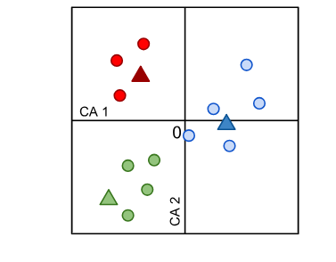
CA –Correspondence Analysis
If you had a "sites x species" matrix, CA would attempt to find a reduced-space answers to:
Which sites do my species prefer?
Which sites to my species correspond to?
inertia
A representation of a CA "joint plot" where both objects (circles, representing rows) and variables (triangles, representing columns) are ordinated

Slide 25
CA –Correspondence Analysis
A variant of PCA using chi-square distances
Euclidean distances weighted by row & column totals
Originally designed for species data that would not work in a PCA
This emphasizes rare species
Assumes that species have unimodal species response curves.
Similar to PCA, suffers from the “arch effect”

Slide 26
CA – warnings!
The Horseshoe/Arch Effect – Detrended Correspondence analysis
Points at the center (the zero point) or at the edges of the ordination may be poorly ordinated
CA is sensitive to outliers and variables with only a few non-zero values (e.g. rare species).
Eigenvalues in CA are not equivalent to those of PCA and should not be interpreted in terms of "variation" but "inertia".

Slide 27
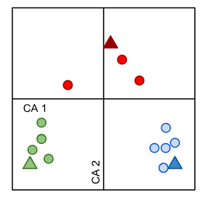
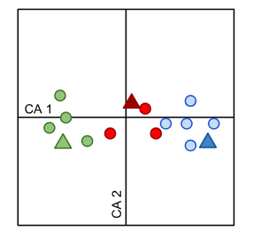
DCA – Detrended Correspondence analysis
(DCA) and was developed and implemented by Hill and Gaugh (1980).
Detrending

Slide 28
DCA – Detrended Correspondence analysis
Scores along a detrended axis are rendered meaningless.

Slide 29
DO NOT USE DETRENDED CORESPONDENCE ANALYSIS!

Slide 30
When to use a DCA!
To determine if you should use a CCA or an RDA
The length of first DCA axis:
> 4 indicates heterogeneous dataset on which unimodal methods should be used (CCA),
< 3 indicates homogeneous dataset for which linear methods are suitable (RDA)
between 3 and 4 both linear and unimodal methods are OK.

Slide 31
CCA –Canonical CA
A constrained ordination method
Displays sample units in environmental space
Constrains a CA based on a sample x species matrix by multiple linear regression with variables from a sample x environment matrix
Ignores community structure unrelated to the environmental variables
Best suited for data where:
Species responses to environment are unimodal
Important underlying environmental variables are known and uncorrelated

Slide 32
Questions appropriate for CCA
Are any aspects of community structure related to these environmental variables?
How is community structure related to these environmental variables?

Slide 33
CCA – the procedure (in brief)
Step 1: start with arbitrary, unequal site scores
Step 2: calculate species scores by weighted averaging of the site scores
Step 3: calculate new site scores (“WA”) by weighted averaging of the species scores
Step 4: obtain regression coefficients by weighted multiple regression of the site scores on the environmental variables
Step 5: calculate new site scores (“LC”) that are the fitted values from the regression
Step 6: adjust site scores to make uncorrelated with previous axes
Step 7: center and standardize the site scores
Step 8: compare previous iteration to check for convergence
Step 9: save site and species scores & then construct additional axes (return to step 1)
Notes:
Steps underlined are CA

Slide 34
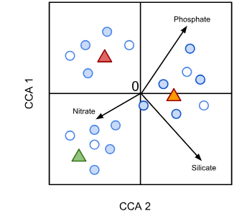
CCA – triplots
Sites in Blue
Species in white
Triangles are Categorical variables
Arrows are Continuous variables

Slide 35
CCA – interpreting triplots
The type of scaling used will determine whether object-to-object or (response) variable-to-variable distances are meaningful.
Smaller object-to-variable distances indicate the increased probability of a given variable being 'present at', 'abundant at', or otherwise influential for a given object.

Slide 36
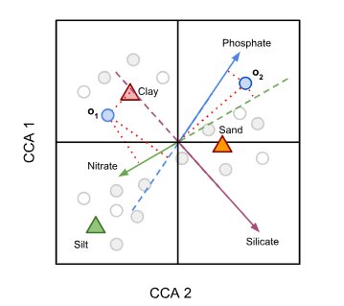
Type 1 scaling emphasizes the relationships among sites. Thus:
Sites act as the centroids of the response variables and the distances between sites points indicate their χ² distances.
A right-angled projection of a site point to a vector representing a continuous explanatory variable approximates the value of the variable for that site.
Sites near centroids representing categorical variables are more likely to realize that state.
Notes:
this example focuses on two objects ("o₁", "o₂"), three quantitative explanatory variables ("Nitrate", "Phosphate", "Silicate") represented by vectors (arrows) pointing in the direction of increase and extended for clarity (dashed lines), and two states of a nominal (qualitative) variable, sediment type ("Sand", "Silt", "Clay"). Orthogonal projections are shown as dotted red lines. Object "o₁" is very likely to be found in clay sediments while object "o₂" is more likely to be found in sand sediments. Perpendicular projections of object "o₁" onto quantitative explanatory variables suggests it realises high values of nitrate concentration, mid-to-low values of phosphate concentration, and low values of silicate concentration. Object "o₂" realises high values of phosphate concentration, mid-range values of silicate concentration and low values of nitrate concentration.

Slide 37
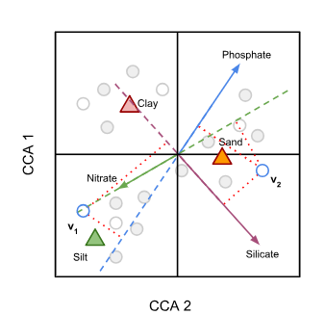
Type 2 scaling emphasizes the relationships among species. Thus:
Species act as the centroids of the objects and the distances between species indicate their χ² distances.
A right-angled projection of a species to an arrow representing an explanatory variable indicates the position of the maximum abundance of the species along that explanatory variable.
The closer a species is to the centroid representing a state of a categorical variable, the more likely that species is to have higher abundance at that state.
Notes:
This example is similar to that in (a), however, points representing response variables ("v₁", "v₂") are now the focus of interpretation. Variable "v₁" is likely to reach its maximum (e.g. highest abundance) in silty sediments at high concentrations of nitrate (projection not shown), mid-to-low concentrations of silicate, and low concentrations of phosphate. Variable "v₂" is likely to reach its maximum in sandy sediments, at mid-to-high phosphate concentrations, low nitrate concentrations and high silicate concentrations.

Slide 38
Type 1 scaling vs. Type 2 scaling?
It depends on the question!!!!

Slide 39
CCA – warnings!
The variables in the explanatory matrix should be chosen with care
If explanatory variables are included too liberally, there is an increased risk of distorting the resulting CCA results.
Only examine the significance and effects of individual axes if the overall CCA solution is found to be significant.
The algorithm used to compute a CCA solution and the exact meaning of the scaling modes may vary across implementations.

Slide 40
RDA – redundancy analysis
RDA produces an ordination that summarizes the main patterns of variation in the response matrix which can be explained by a matrix of explanatory variables.
Analogous to CCA with Euclidean distances
Displays sample units in environmental space
Constrains a PCA based on a sample x species matrix by multiple linear regression with variables from a sample x environment matrix
Best suited for data where:
Species responses to environment are linear
Important underlying environmental variables are known and uncorrelated

Slide 41
RDA – results
The total variance of the data set is partitioned into constrained and unconstrained variances.
This tells us how much variation in our response variables was redundant with the variation in our explanatory variables.
If the constrained variance > unconstrained variance,
much of the variation in the response data may be accounted for by your explanatory variables
If the constrained variance < unconstrained variance,
results should be interpreted with caution
only a small amount of the variation in your response matrix is displayed.

Slide 42
RDA – results
A significance values (based on permutation) can be assessed for:
the overall RDA (or CCA) solution
individual RDA (or CCA) axes
only if the overall solution is significant should the significance of individual axes or explanatory variables be examined.

Slide 43
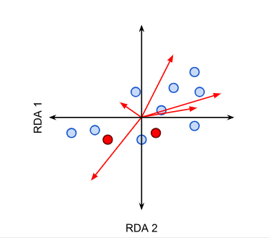
RDA – biplots and triplots
An RDA biplot ordinates sites as points and either Species or Environmental variables as vectors (red arrows). Levels of categorical variables are plotted as points (red).

Slide 44
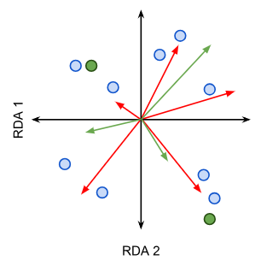
RDA – biplots and triplots
In a triplot, sites are ordinated as points (blue) while both Species and Environmental variables (red and green arrows resp.) are plotted as vectors. Levels of categorical variables are plotted as points (green).

Slide 45
RDA – scaling
The type of scaling used will determine whether object-to-object or (response) variable-to-variable distances are meaningful.
Type 1 scaling
if the distances between objects are of particular intrest
if most explanatory variables are binary or categorical
Type 2 scaling
if the correlative relationships between variables are of more interest

Slide 46
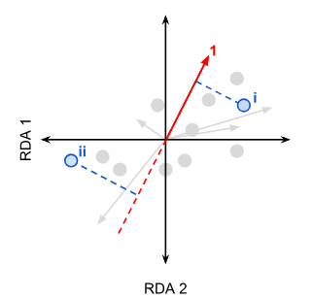
Type 1 scaling emphasizes the relationships among sites. Thus:
Distances between object points approximate Euclidean distances. Thus, objects ordinated closer together can be expected to have similar variable values
A right-angled projection of a site point to a vector representing a continuous explanatory variable approximates the value of the variable for that site.
The angles between vectors representing response variables are meaningless
Notes:
a) the projection of ordinated objects onto a vector and b) the angles between vectors. The projection of an ordinated point onto a variable vector, as shown for point i in panel a, approximates the variable's value realised for that object. Hence, visual inspection suggests object i can be expected to have higher values of variable 1 relative to most other objects. Object ii, however, can be expected to have lower values of variable 1 relative to other objects. Note that the dashed line is not typically shown in a biplot and is shown here for clarity.

Slide 47
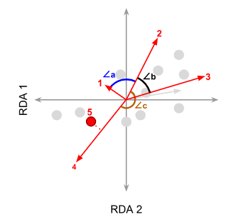
Type 2 scaling emphasizes the relationships among response variables. Thus:
Distances between object points should not be considered to approximate Euclidean distances
Right-angled projections of object points onto vectors representing response variables approximate variable values for a given object.
The angles between all vectors reflect their (linear) correlation. The correlation is equal to the cosine of the angle between vectors
Notes:
When using type II scaling, the cosines of angles between vectors (panel b) approximate the correlation between the variables they represent. In this case, ∠a is approaching 90, which suggests that variables "1" and "2" show very little correlation (i.e. they are almost orthogonal, just as independent axes are). ∠b is less than 90°, suggesting positive correlation between variables "2" and "3" while ∠c is approaching 180°, suggesting strong negative correlation between variables "2" and "4" (i.e. the directions of increase of variables "2" and "4" oppose one another). Variable 5 is non-quantitative and is represented by a centroid. A right-angled projection onto variable 4 suggests the two are positively linked.

Slide 48
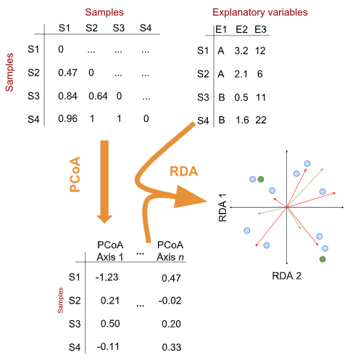
dbRDA – distance-based RDA
A special case that swaps out a site x species matrix for a dissimilarity matrix
RDA based on PCA
dbRDA based on PCoA
We will talk about this more in module 9

Slide 49
Community composition data
Environmental data
Visualize
Summarize for univariate analyses
NMDS
PCoA
PCA
Analyze linkages
unimodal
linear
db
CCA
RDA
dbRDA

